Slide 1
Transfer Learning

Slide 2
ELMo
BERT
Case study
GPT-2
XLNet

Slide 3


ELMo
The Elmo we are referring to is not the character from Sesame street.
It stands for Embeddings from Language Models.
It’s a powerful state of the art NLP framework developed by AllenNLP.

Slide 4
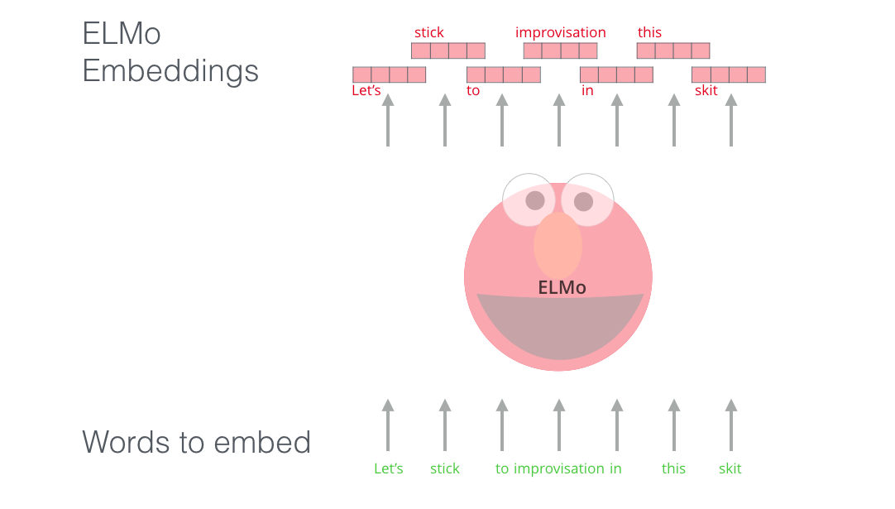
Why do we need Elmo?
Elmo is a novel way to represents words in vectors or embeddings.
These embeddings are helpful in achieving state of the art result in various NLP tasks.

Slide 5

What’s new with Elmo? Context
Unlike word2vec or Glove which uses a dictionary of words and their corresponding vectors, ELMO analyzes words within the context they are used.

Slide 6
Deep Contextualized Word Representations
Words can have different meaning based on the context they are used.
He kicked the bucket.
I have yet to cross-off all the items on my bucket list.
The bucket was filled with water.
Here each sentence will have a different embedding for bucket.
Elmo understands this by using a deep bidirectional LSTM network to create word representation.
It is also character based, allowing the model to form representation of out of vocabulary words.

Slide 7
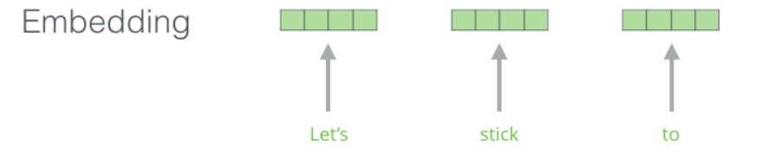
How does ELMo works?
Step 1: Character level Convolutional Neural Network to represent word into new word vector.
These raw vectors are input to the first layer of Bi-directional LSTM network.

Slide 8
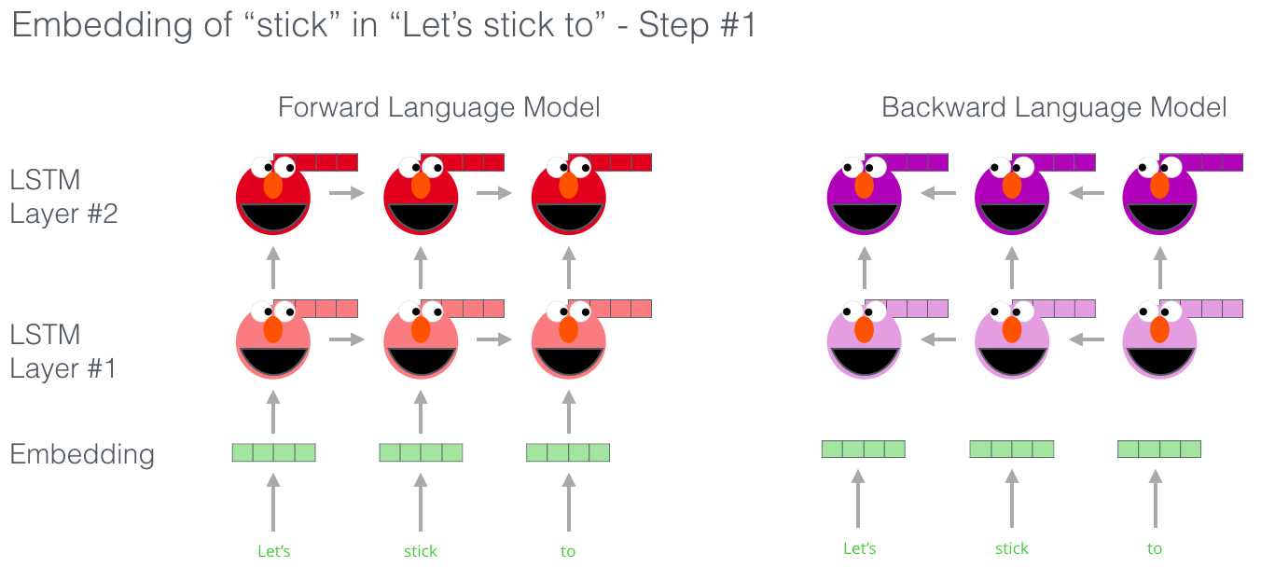
Forward Language Model and Backward Language Model
Forward language model contains information about a certain word and context before that word.
Backward language model contains information about a certain word and the context after it.

Slide 9
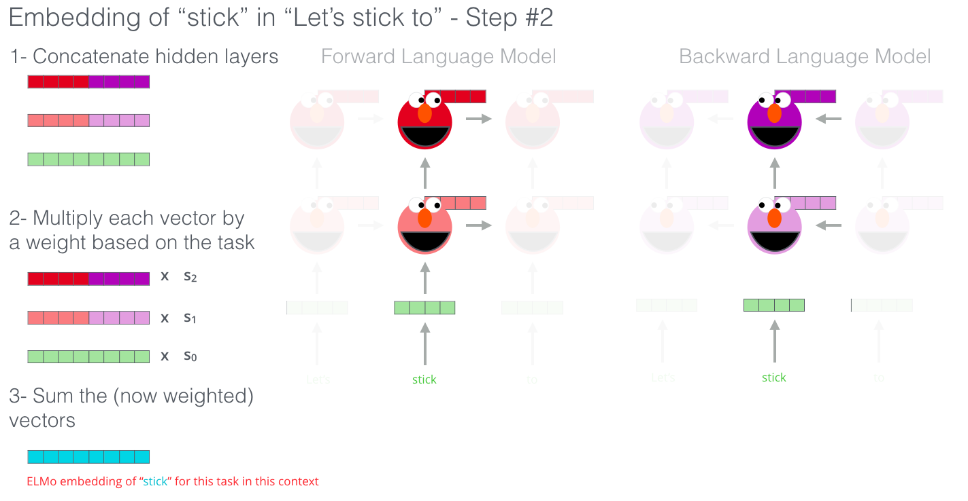
Intermediate word vector and final ELMo representation
Intermediate word vectors
Final ELMo
representation

Slide 10
ELMo Training Steps
Notes:
**GIF

Slide 11
ELMo
BERT
Case study
GPT-2
XLNet

Slide 12
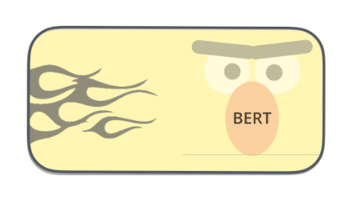

BERT
BERT is a powerful NLP model developed by Google AI.
BERT stands for Bidirectional Encoder Representations from Transformers.
The release of BERT is a landmark event which accelerated the developments in the field of NLP.

Slide 13
Power of BERT
BERT is designed to pre-train deep bidirectional representations from unlabeled texts.
It is able to understand both left and right context in all layers.
As a result, pre-trained BERT model can be fine tuned with just one additional output layer to create state of the art results in a eleven natural language processing tasks such as :
Question Answering
Language Inference

Slide 14
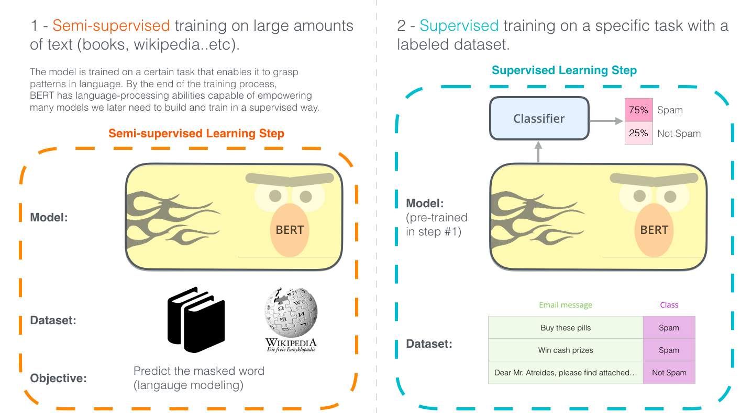
BERT pre-training and finetuning

Slide 15
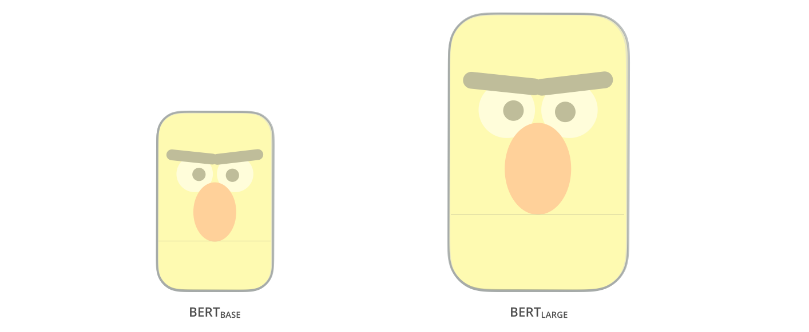
BERT Models
Two model sizes of BERT were released:
BERT BASE – Comparable in Size with OpenAI Transformer in order to compare performance
BERT LARGE – A ridiculously large model which achieved state of the art result as shown in the paper

Slide 16
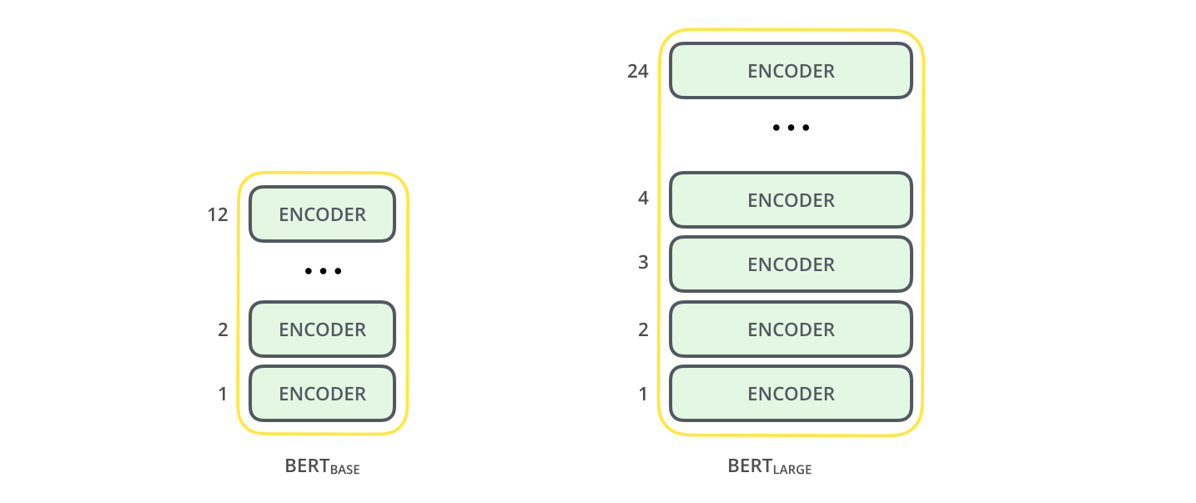
BERT Architecture?
BERT is basically a trained Transformer Encoder Stack.
Both BERT models have a large number of Transformer Encoder Layers – 12 for base version and 24 for large version.

Slide 17
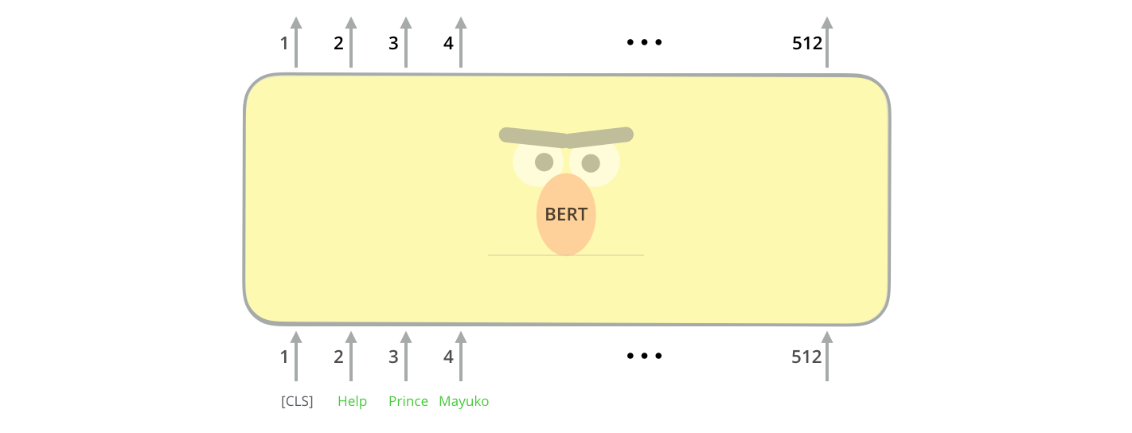
How is BERT trained?
The first token is a special [CLS] token. CLS here stands for classification.

Slide 18
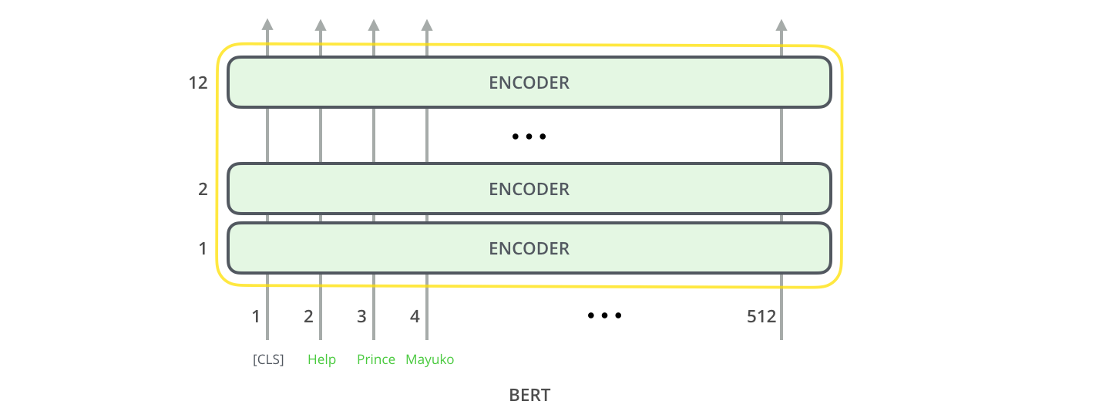
How is BERT trained?
BERT takes in a sequence of words as inputs which keep flowing up the stack.
Each layer applies self-attention & passes the result to a feed forward network.
The result is passed to the next encoder.

Slide 19
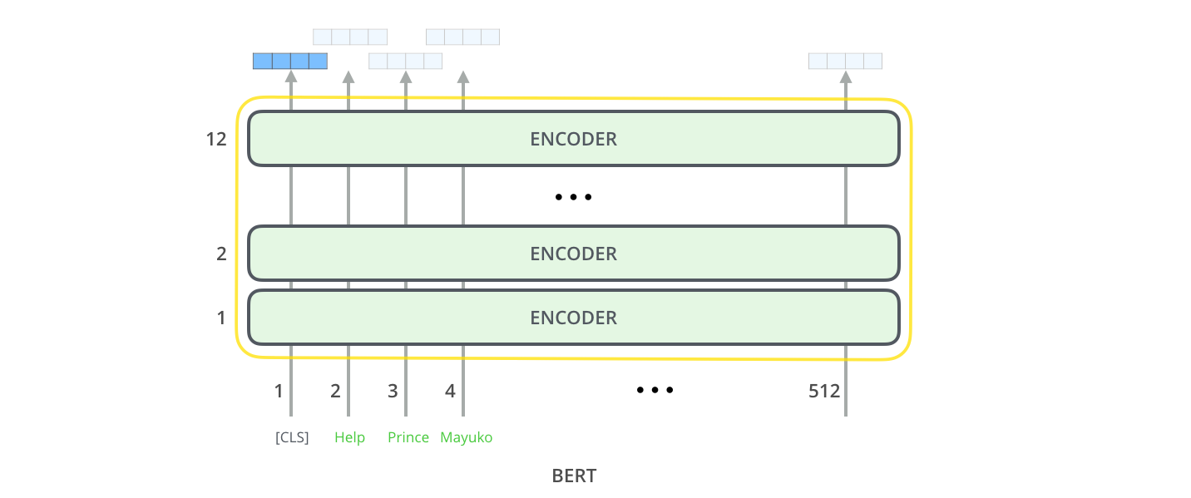
How is BERT trained?
In the final encoder at output each position produces a vector of size 768(BASE) and 1024(LARGE).
Notes:
** The original BERT paper had 512 hidden units as shown in image

Slide 20
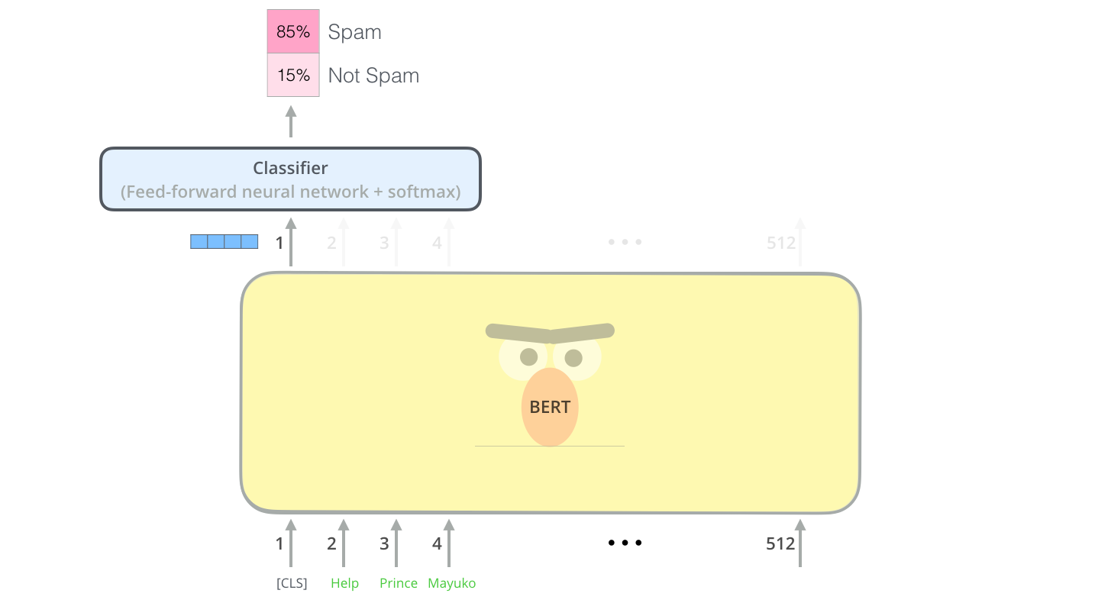
How is BERT trained?
We are interested in the output of [CLS] tag.
This vector can be used as an input to classifier model.
We can use a single layer neural network as a classifier which can provide great results.

Slide 21
ELMo
BERT
XLNet
GPT-2
Case study

Slide 22
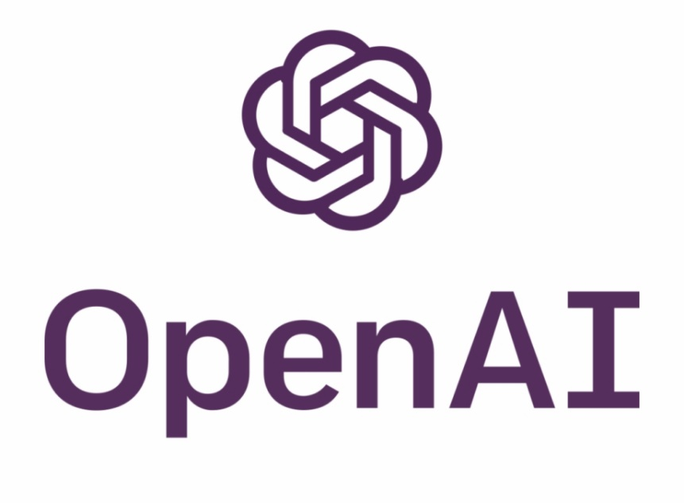
GPT-2
GPT-2 is a powerful state of the art NLP framework developed by OpenAI.
It is currently the most advanced model in the world.

Slide 23
Use of GPT-2
GPT-2 is a pretrained language model used for various NLP tasks such as:
Text generation
Language Translation
Building question answering systems
It is indeed one of the most powerful text generation model in the world which can understand the context behind each sentence. It uses this context to generate the next word and sentence and so on.
It was a model which was trained on 40GB of Internet text.
The full model has 1.5 billion parameters, which has shattered all the benchmarks of previous state of the art models.

Slide 24
Implications of GPT-2
Large language models such as GPT-2 can have significant impact such as :
AI writing assistant
More capable dialogue agents
Unsupervised translation between languages
Better speech recognition systems
In a similar sense, there can be malicious use of such models for:
Generating misleading news articles
Automate the production of abusive or fake content
Fake news

Slide 25
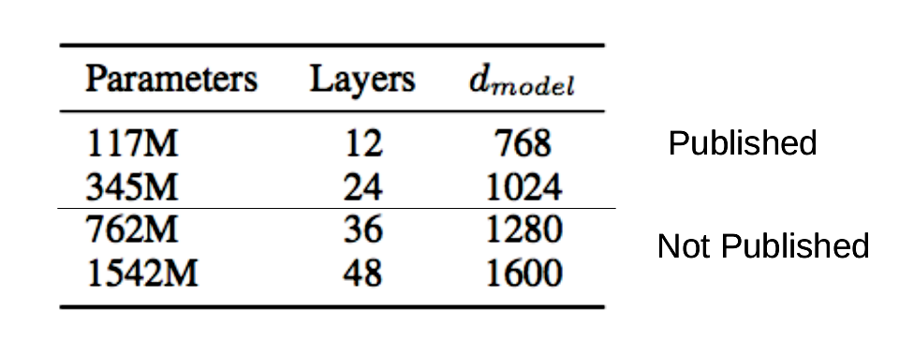
Models of GPT-2
Because of the potential misuse of this model, smaller models with fewer parameters have been released yet.

Slide 26
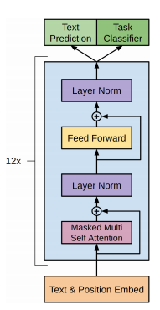
GPT-2 Architecture
This architecture is similar to transformer encoder.
This GPT-2 model has 12 encoder layers.
Each encoder has a self attention and feed forward network just as a transformer.
The only difference is presence of normalization blocks.

Slide 27
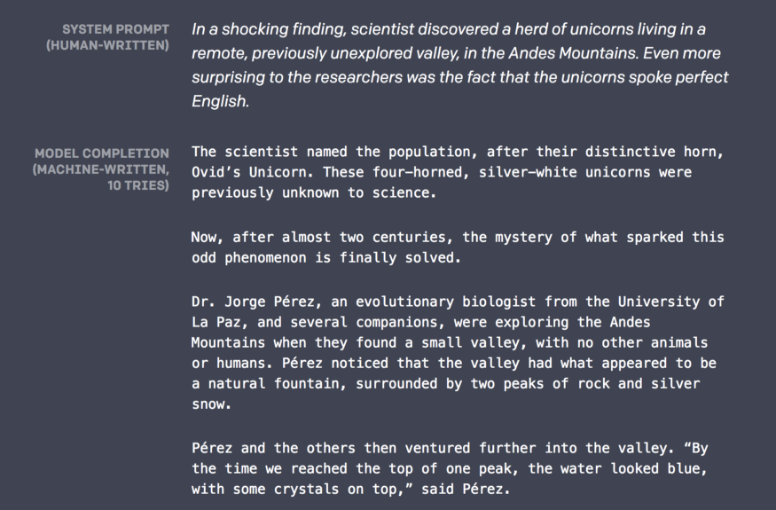
Text Generation Example using GPT-2

Slide 28

Text Generation Example using GPT-2

Slide 29
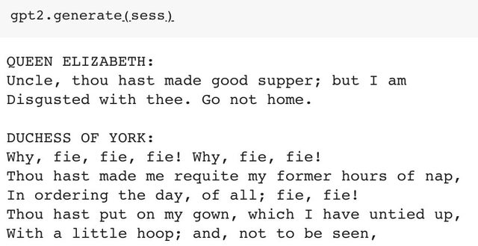
Text Generation Example using GPT-2
Notes:
** Add multiple examples of GPT-2

Slide 30
ELMo
BERT
Case study
GPT-2
XLNet

Slide 31
XL Net
XL Net is the new NLP model which
improves upon BERT on 20 tasks by a large margin.
It has achieved state-of-the-art results on 18 tasks including question answering, natural language inference, sentiment analysis and document ranking.

Slide 32

What is XL Net?
XL Net is similar to BERT and not an entirely different model.
It is essentially a generalized autoregressive pretraining model.
Notes:
https://medium.com/dair-ai/xlnet-outperforms-bert-on-several-nlp-tasks-9ec867bb563b

Slide 33
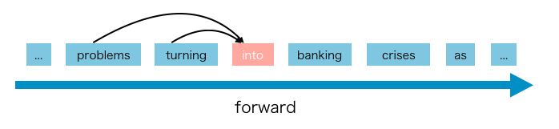
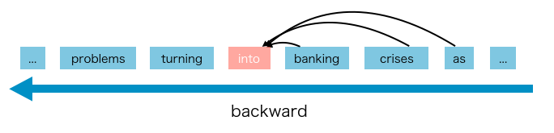
What is Auto Regressive Language Model?
AR Language model is a kind of model which uses the context word to predict the next word.
GPT and GPT-2 are examples of AR model.
But the problem with AR models is that it can use only forward context or backward context at a time.
Notes:
https://mlexplained.com/2019/06/30/paper-dissected-xlnet-generalized-autoregressive-pretraining-for-language-understanding-explained/

Slide 34
How to gather context from both sides: Permutation
Every language model consists of two phases, the pre-train phase and fine-tune phase.
In the pre-train phase XLNet uses a new objective called Permutation Language Modelling to learn bidirectional context.
Notes:
Gif

Slide 35
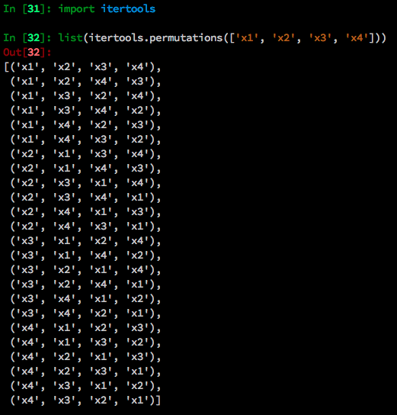
Permutation Language Model
If we have a sequence order [x1, x2, x3, x4].
All the permutation of this sequence will be:
So for these 4 tokens, there are 24 (N!) permutations.
Notes:
Gif

Slide 36
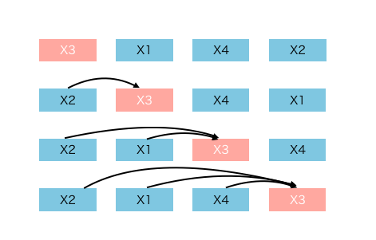
Permutation Language Model
If we want to predict x3 at position t, we will have to use all the tokens preceding t-1 for context.
The words before x3 will have every possible words and length in sequence.
The model will learn to gather information from all positions in both sides using attention similar to BERT.
Using this context, it will predict x3.
Notes:
Gif

Slide 37
ELMo
BERT
Case study
GPT-2
XLNet

Slide 38
The Experiment
Please refer to the hands on Notebook

